Slide 1

ICICTA-2023
Title – Image Segmentation and Object Identification using Deep Learning
Presented By,
1. Prince Kumar – R21DE179, (Program - MCA), Sec – ‘C’, Sem – ‘IV’
2. Prof. Nagaraju S

Slide 2
Introduction –
An image is split into parts or regions, each of which represents a different item or element of the image, using a process called image segmentation in computer vision.
The technique of categorizing or recognizing an image based on its content is known as image identification.
Computer vision techniques, to requires studying the image and determining its features, such as shapes, colors, and textures.
Abstract –
Digital image segmentation divides an image into several areas or portions based on the properties of an image pixels. The image segmentation of an image is the process of breaking it up smaller groups.
Computer vision algorithms may be used to extract elements like color, texture, and form in order to recognize abstract art images.
Image identification or image recognition refers to the task of identifying what is present in an image.
This can include recognizing specific objects, scenes, or patterns within an image.

Slide 3
ALGORITHMS OF IMAGE SEGMENTATION
ALGORITHMS OF IMAGE IDENTIFICATION
SI. No. | NAME OF ALGORITHM
1 | Thresholding Segmentation.
2 | Region Growing Segmentation.
3 | Watershed Transform Segmentation.
4 | Graph Segmentation.
5 | Cluster Segmentation.
6 | Mean-Shift Segmentation.
7 | Active Counters Segmentation.
8 | Edge Segmentation.
SI. No. | NAME OF ALGORITHM
1 | Convolutional Neural Networks. [CNNs]
2 | Support Vector Machines. [SVMs]
3 | K-Nearest Neighbors. [KNNs]
4 | Decision Trees. [DTs]
5 | Deep Belief Networks. [DBNs]
6 | Random Forests. [RFs]
Methodologies used in Image Segmentation –
Fully convolutional neural networks. [FCN]
Convolutional networks for biomedical image segmentation. [U-Net]
Regions with convolutional neural networks. [Mask R-CNN]
Deep labeling for semantic image segmentation. [DeepLab]
Semantic segmentation model. [SegNet]
Methodologies used in Image Identification –
Convolutional neural networks. [CNN]
Transfer Learning. [TL]
Recurrent neural networks. [RNN]
Siamese networks. [SN]
Generative adversarial networks. [GAN]

Slide 4
ARCHITECTURE
ARCHITECTURE OF IMAGE SEGMENTATION –
Data Preprocessing.
Convolutional Neural Network.
Encoder-Decoder.
Contracting Path.
Expanding Path.
Skip Connections.
Activation Functions.
Loss Function and Optimization.
Post-Processing.
ARCHITECTURE OF IMAGE IDENTIFICATION –
Data Preprocessing.
Convolutional Neural Network.
Convolutional Layers.
Pooling Layers.
Fully Connected Layers.
Activation Function.
Loss Function and Optimization.
Transfer Learning.

Slide 5
Result –
An image that has been segmented using deep learning and machine learning is one in which the original image has been separated into several areas or segments depending on the objects or features seen in the image.
CNNs and encoder-decoder architectures like U-Net, FCNs, Mask R-CNNs, model has attained cutting-edge performance in instance segmentation tasks, and the VGG and ResNet models have excelled in picture classification tasks on sizable benchmark datasets like ImageNet are often used in machine learning and deep learning models for image segmentation.

Slide 6
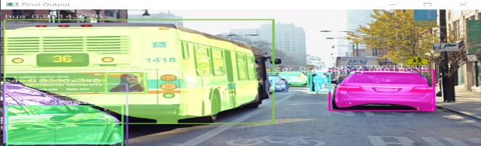
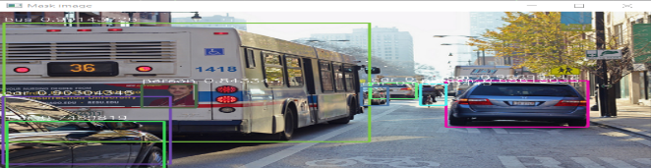
Image Segmentation –
Image Identification –
Fig : Final Image, Bus, Cars, Person.
Fig : Mask Image, Bus, Cars, Person.

Slide 7
CONCLUSION –
In conclusion, deep learning has significantly improved performance in the critical computer vision tasks of image segmentation and image identification.
CNNs, one type of deep learning and machine learning model, have displayed outstanding performance in both image segmentation and image identification tests. While VGG, ResNet, and Inception are frequently used for image recognition, FCNs, U-Net, and Mask R-CNN are popular model for image segmentation.
In a few benchmark datasets, including as the Pascal VOC 2012 segmentation challenge, COCO dataset for instance segmentation, and ImageNet Large Scale Visual Recognition Challenge for image classification, deep learning models have demonstrated state-of-the-art performance.
Deep learning implementation of these tasks, however, necessitates extensive data preparation, model selection, and hyperparameter tweaking. Deep learning models may also have drawbacks include overfitting to the training data, difficulty deciphering the learnt features, and sensitivity to changes in the distribution of the input data.

Slide 8
THANK YOU

